Slide 1
Verilog HDL语言
主讲：胡燏翀
Email: yuchonghu@hust.edu.cn
华中科技大学计算机科学与技术学院

Slide 2
Verilog程序设计方法

Slide 3
Outline
三种描述的举例说明
结构描述
数据描述
行为描述

Slide 4
Module Styles
Modules can be specified different ways
  Structural – connect primitives and modules
  Dataflow– use continuous assignments
  Behavioral – use initial and always blocks
  在模块和端口定义好以后，首先选择用哪种方法来描述。不同方式的难易程度不一样。
A single module can use more than one method!
What are the differences?

Slide 5
Structural Example
module majority (major, V1, V2, V3) ; //表决器，如果有两个输入是1，则输出为1；如果有两个输入是0，则输出为0。少数服从多数。
output major ;
input V1, V2, V3 ;
wire N1, N2, N3;//线网型声明
and A0 (N1, V1, V2),
A1 (N2, V2, V3),
A2 (N3, V3, V1);
or Or0 (major, N1, N2, N3);
endmodule
V1
N1
A0
V2
V2
A1
N2
Or0
major
V3
V3
A2
N3
V1
majority

Slide 6
Dataflow Example
module majority (major, V1, V2, V3) ;
output major ;
input V1, V2, V3 ;
assign major = V1 & V2
| V2 & V3
| V1 & V3;
endmodule
majority
V1
V2
major
V3

Slide 7
Behavioral Example
module majority (major, V1, V2, V3) ;
output reg major ;
input V1, V2, V3 ;
always @(V1, V2, V3) begin
if (V1 && V2 || V2 && V3
|| V1 && V3) major = 1;
else major = 0;
end
endmodule
majority
V1
V2
major
V3
Notes:
注意：必须output reg major 不能掉reg

Slide 8
Full Adder: Structural
module half_add (X, Y, S, C);
input X, Y ;
output S, C ;
xor SUM (S, X, Y);
and CARRY (C, X, Y);
endmodule
module full_add (A, B, CI, S, CO) ;
input A, B, CI ;
output S, CO ;
wire S1, C1, C2;
// build full adder from 2 half-adders
half_add PARTSUM (A, B, S1, C1),
SUM (S1, CI, S, C2);
// … add an OR gate for the carry
or CARRY (CO, C2, C1);
endmodule
Slide taken direct from Prof. Schulte

Slide 9
Full Adder: Dataflow/RTL
module fa_rtl (A, B, CI, S, CO) ;
input A, B, CI ;
output S, CO ;
// use continuous assignments
assign S = A ^ B ^ CI;
assign C0 = (A & B) | (A & CI) | (B & CI);
endmodule
Data flow Verilog is
often very concise
and still easy to read
Works great for most
boolean and even
datapath descriptions
Slide taken direct from Eric Hoffman

Slide 10
Full Adder: Behavioral
Circuit “reacts” to given events (for simulation)
  Actually list of signal changes that affect output
module fa_bhv (A, B, CI, S, CO) ;
input A, B, CI;
output S, CO;
reg S, CO; // assignment made in an always block
// must be made to registers
// use procedural assignments
always@(A or B or CI)
begin
S = A ^ B ^ CI;
CO = (A & B) | (A & CI) | (B & CI);
end
endmodule
Slide taken direct from Prof. Schulte

Slide 11
三种描述的特点
结构化描述：抽象级别最低，最接近于实际的硬件结构。
  缺点：随芯片的集成度越来越高，项目的复杂性越来越大，要想纯粹使用这种描述方式完成FPGA设计，已经不是人类所能做到的。
  优点：层次化的模块划分是FPGA设计思想的主流，父模块调用子模块的过程只能通过结构化的描述方式来实现。

Slide 12
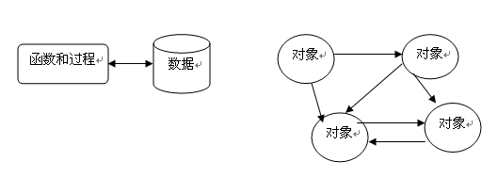
小知识（关于结构化）
1. 结构化程序设计（structured programming）是进行以模块功能和处理过程设计为主的详细设计的基本原则。其概念最早由E.W.Dijikstra在1965年提出的，是软件发展的一个重要的里程碑。它的主要观点是采用自顶向下、逐步求精及模块化的程序设计方法。
2. 结构化 vs 面向对象：结构化的缺点是模块由函数实现，完成对输入数据的加工和计算，数据和功能是分离的；如果数据的结构发生变化，相应的操作函数就不得不重新改写。而面向对象把数据和功能封装在对象中形成整体，通过对对象的管理和对象间的通讯实现软件功能。

Slide 13
三种描述的特点
结构化描述：抽象级别最低，最接近于实际的硬件结构。
  缺点：随芯片的集成度越来越高，项目的复杂性越来越大，要想纯粹使用这种描述方式完成FPGA设计，已经不是人类所能做到的。
  优点：层次化的模块划分是FPGA设计思想的主流，父模块调用子模块的过程只能通过结构化的描述方式来实现。
数据流描述：比结构化描述方式抽象级别要高一些，无需清晰地刻画出具体的数字电路，而直观地表达底层的逻辑行为。
  缺点：抽象级别远没有行为级描述高，所以只适用于小规模的电路设计。
  优点：既显式地表达了模块的行为，又隐式地刻画了模块的电路结构。因此对于功能较为简单的模块可以轻松利用数据流描述来实现，这样对设计者和编译器都方便；而对于复杂的模块，一般都是行为级描述为主，数据流描述方式为辅。

Slide 14
三种描述的特点
结构化描述：抽象级别最低，最接近于实际的硬件结构。
  缺点：随芯片的集成度越来越高，项目的复杂性越来越大，要想纯粹使用这种描述方式完成FPGA设计，已经不是人类所能做到的。
  优点：层次化的模块划分是FPGA设计思想的主流，父模块调用子模块的过程只能通过结构化的描述方式来实现。
数据流描述：比结构化描述方式抽象级别要高一些，无需清晰地刻画出具体的数字电路，而直观地表达底层的逻辑行为。
  缺点：抽象级别远没有行为级描述高，所以只适用于小规模的电路设计。
  优点：既显式地表达了模块的行为，又隐式地刻画了模块的电路结构。因此对于功能较为简单的模块可以轻松利用数据流描述来实现，这样对设计者和编译器都方便；而对于复杂的模块，一般都是行为级描述为主，数据流描述方式为辅。
行为描述：行为级描述方式的抽象级别更高，概括力更强，因此规模稍微大些的设计，往往都以行为级描述方式为主。

Slide 15
三种描述的特点
结构化描述方式直接给出底层电路结构，数据流描述方式间接给出底层电路结构，而行为级描述方式几乎就不给出底层电路结构。
无论采用何种描述方式，这中间的工作量是一致的，只不过不同的描述方式分配给人脑和电脑的工作量不同而已。

Slide 16
。

Slide 17
Outline
三种描述的举例说明
结构描述
  原语
数据描述
行为描述

Slide 18
Structural Basics: Primitives
Build design up from the gate/flip-flop/latch level
  Structural verilog is a netlist of blocks and connectivity
Verilog provides a set of gate primitives
  and, nand, or, nor, xor, xnor, not, buf, bufif1, etc.
  Combinational building blocks for structural design
  Cannot access “inside” description

Slide 19

小知识（关于原语Primitives）
原语：计算机用语范畴，常见于操作系统或计算机网络。由若干个机器指令构成的完成某种特定功能的一段程序，具有不可分割性：即原语的执行必须是连续的，在执行过程中不允许被中断。比如，操作系统层面上的“原语”（比如 write 之类的系统调用）对程序员来讲的确是不可分割的最小单位
除了“石头”是原语，而“剪刀”和“布头”不算，因为剪刀和布头都是人工合成的，而石头是浑然天成的。我们看到一把剪刀以后很容易想到它的各个组成部分（比如锋利的部分用铁制成，而握的地方用塑料），而看到一块石头以后，脑子里还是只有一块石头。
Notes:
原因是在人类形成最早语言的过程中还不知道什么是矿物质，众所周知人类的视力其实是很差的，只能看到光谱上面很小的一段可见光，也不能像显微镜一样看见的东西，直到道尔顿发现原子，人类科学才算走上了正轨。
计算机是一门人造科学，因此真正意义上的“原语”是不存在的。操作系统层面上的“原语”（比如 write 之类的系统调用）对程序员来讲的确是不可分割的最小单位，但是这写系统调用本身还是用好几句汇编语句组成的（对于 Linux 来说是 C 语言）。可能有人要说到了机器代码这一级就不能再分了，但事实上一条机器指令也是由好几个组合逻辑信号构成的。同样的道理，控制信号也不过是无数电子在器件内部漂移的结果。
因此定义“原语”的前提是观察者所处的位置。一旦规定了观察者的位置和观察的角度，比如就在操作系统的这层上，read，wirte，wait这些个系统调用自然就是最“原始”的词汇，这也是为什么“原语”会在操作系统中频繁出现的缘故。

Slide 20
Primitives
No declarations - can only be instantiated
Output port appears before input ports
Optionally specify: instance name and/or delay (discuss delay later)
and N25 (Z, A, B, C); // name specified
and #10 (Z, A, B, X),
(X, C, D, E); // delay specified, 2 gates
and #10 N30 (Z, A, B); // name and delay specified

Slide 21
Outline
三种描述的举例说明
结构描述
  原语
  语法
数据描述
行为描述

Slide 22
Syntax For Structural Verilog
First declare the interface to the module
  Module keyword, module name
  Port names/types/sizes
Next, declare any internal wires using “wire”
  wire [3:0] partialsum;
Then instantiate the primitives/submodules
  Indicate which signal is on which port

Slide 23
Outline
三种描述的举例说明
结构描述
  原语
  语法
  分层/模块化
数据描述
行为描述

Slide 24
Hierarchy
Interface (“black box” representation)
  Module name, ports
Definition
  Describe functionality of the block
Instantiation
  Use the module inside another module

Slide 25
模块
无论多么复杂的系统，总能划分成多个小的功能模块。系统的设计可以按照下面三个步骤进行：
（1）把系统划分成模块；
（2）规划各模块的接口；
（3）对模块编程并连接各模块完成系统设计。
模块的结构：
module <模块名>（<端口列表>）；
<定义>：一段程序，用来指定数据对象为寄存器型、存储器型、线型以及过程块，诸如函数块和任务块；
<模块条目>：一段程序，将上面<定义>和<端口>组合起来，是说明这个模块要做什么的语句；
endmodule

Slide 26
模块
模块的调用：
1）引用时，严格按照模块定义的端口顺序来连接，不用标明原模块定义时规定的端口名。
Design u_1(u_1的端口1，u_1的端口2，……)；
2）引用时用”.”符号，标明原模块定义时规定的端口名， 这样当被调用的模块管脚改变时不易出错。
Design u_2( .(端口1(u_1的端口1),
.(端口2(u_1的端口2),
…… );
eg.
module and (C,A,B);
input A,B;
output C;
...
and A1 (T3,A,B); //实例化时采用位置关联，T3对应输出端口C，A对应A，B对应B。
and A2 ( .C(T3),
.A(A),
.B(B) )；//实例化时采用名字关联，.C是and器件的端口，其与信号T3相连

Slide 27
Hierarchy
Build up a module from smaller pieces
  Primitives
  Other modules (which may contain other modules)
Design: typically top-down
Verification: typically bottom-up
Full Adder Hierarchy
Add_full
Add_half
Add_half
or
xor
and
xor
and

Slide 28
Add_half Module
Add_half
xor
and
module Add_half(c_out, sum, a, b);
output sum, c_out;
input a, b;
xor sum_bit(sum, a, b);
and carry_bit(c_out, a, b);
endmodule

Slide 29
Add_full Module
Add_full
Add_half
Add_half
or
module Add_full(c_out, sum, a, b, c_in) ;
output sum, c_out;
input a, b, c_in;
wire w1, w2, w3;
Add_half AH1(.sum(w1), .c_out(w2), .a(a), .b(b));
Add_half AH2(.sum(sum), .c_out(w3), .a(c_in), .b(w1));
or carry_bit(c_out, w2, w3);
endmodule
.sum 是引用的写法，这样的话，可以在参数引入的时候不用管顺序
Notes:
.sum 是引用的写法，这样的话，可以在参数引入的时候不用管顺序

Slide 30
Add_full Module
Add_full
Add_half
Add_half
or
Add_half AH1(.sum(w1), .c_out(w2), .a(a), .b(b));
最好写成
Add_half AH1(
.sum(w1),
.c_out(w2),
.a(a),
.b(b)
);

Slide 31
Can Mix Styles In Hierarchy!
module Add_half_bhv(c_out, sum, a, b);
output reg sum, c_out;
input a, b;
always @(a, b) begin
sum = a ^ b;
c_out = a & b;
end
endmodule
module Add_full_mix(c_out, sum, a, b, c_in) ;
output sum, c_out;
input a, b, c_in;
wire w1, w2, w3;
Add_half_bhv AH1(.sum(w1), .c_out(w2),
.a(a), .b(b));
Add_half_bhv AH2(.sum(sum), .c_out(w3),
.a(c_in), .b(w1));
assign c_out = w2 | w3;
endmodule

Slide 32
Hierarchy And Source Code
Can have all modules in a single file
  Module order doesn’t matter!
  Good for small designs
  Not so good for bigger ones
  Not so good for module reuse (cut & paste)
Can break up modules into multiple files
  Helps with organization
  Lets you find a specific module easily
  Good for module reuse (add file to project)

Slide 33
Structural Verilog: Connections
Positional or Connect by reference
  Can be okay in some situations
    Designs with very few ports
    Interchangeable input ports (and/or/xor gate inputs)
  Gets confusing for large #s of ports
module dec_2_4_en (A, E_n, D);
input [1:0] A;
input E_n;
output [3:0] D;
.
.
.
wire [1:0] X;
wire W_n;
wire [3:0] word;
// instantiate decoder
dec_2_4_en DX (X, W_n, word);
Partial code instatiating decoder

Slide 34
Structural Verilog: Connections
Explicit or Connect by name method
  Helps avoid “misconnections”
  Don’t have to remember port order
  Can be easier to read
  .<port name>(<signal name>)
wire [1:0] X;
wire W_n;
wire [3:0] word;
// instantiate decoder
dec_2_4_en DX (.A(X), .E_n(W_n), .D(word));
module dec_2_4_en (A, E_n, D);
input [1:0] A;
input E_n;
output [3:0] D;
  .
  .
  .
Partial code instatiating decoder

Slide 35
Empty Port Connections
Example: module dec_2_4_en(A, E_n, D);
  dec_2_4_en DX (X[1:0], , word); // E_n is high impedence (z)
  dec_2_4_en DX (X[1:0], W_n , ); // Outputs D[3:0] unused.
General rules
  Empty input ports => high impedance state (z)
  Empty output ports => output not used
Specify all input ports anyway!
  Z as an input is very bad…why?
Helps if no connection to output port name but leave empty:
  dec_2_4_en DX(.A(X[3:2]), .E_n(W_n), .D());

Slide 36
Outline
三种描述的举例说明
结构描述
数据描述
行为描述

Slide 37
Dataflow Verilog
The continuous assign statement
  It is the main construct of Dataflow Verilog
  It is deceptively powerful & useful
Generic form:
assign [drive_strength] [delay] list_of_net_assignments;
Where:
list_of_net_assignment ::= net_assignment [{,net_assignment}]
& Where:
Net_assignment ::= net_lvalue = expression
OK…that means just about nothing to me…how about some examples?

Slide 38
Continuous Assign Examples
Simplest form:
  // out is a net, a & b are also nets
  assign out = a & b; // and gate functionality
Using vectors
  wire [15:0] result, src1, src2; // 3 16-bit wide vectors
  assign result = src1 ^ src2; // 16-bit wide XOR
Can you implement a 32-bit adder in a single line?
  wire [31:0] sum, src1, src2; // 3 32-bit wide vectors
  assign {c_out,sum} = src1 + src2 + c_in; // wow!
Notes:
一条语句就可以做一个全加器！！WoW！

Slide 39
Back to the Continuous Assign
More basic generic form:
assign <LHS> = <RHS expression>;
If RHS result changes, LHS is updated with new value
  Constantly operating (“continuous”)
  It’s hardware!
  RHS can use operators (i.e. +,-,&,|,^,~,>>,…)
src1[31:0]
src2[31:0]
c_in
➔
assign {c_out,sum} = src1 + src2 + c_in;
c_out
sum[31:0]

Slide 40
Lets Kick up the Horse Power
You thought a 32-bit adder in one line was powerful. Lets try a 32-bit MAC…
Design a multiply-accumulate (MAC) unit that computes
Z[31:0] = A[15:0]*B[15:0] + C[31:0]
It sets overflow to one, if the result cannot be represented using 32 bits.
module mac(output [31:0] Z, output overflow,
input [15:0] A, B, input [15:0] C);

Slide 41

Lets Kick up the Horse Power
module mac(output [31:0] Z, output overflow,
input [15:0] A, B, input [31:0] C);
assign {overflow, Z} = A*B + C;
endmodule
I am a brilliant genius. I am a HDL coder extraordinaire. I created a 32-bit MAC, and I did it in a single line.
assign {overflow, Z} = A*B + C;
Oh my god, I’ve created a monster
Synopsys
Notes:
有时候机器对数据流进行翻译的时候，有可能会变成很大的电路。
所以有时候即使功能是正确的，但电路很可能还是很负责。

Slide 42
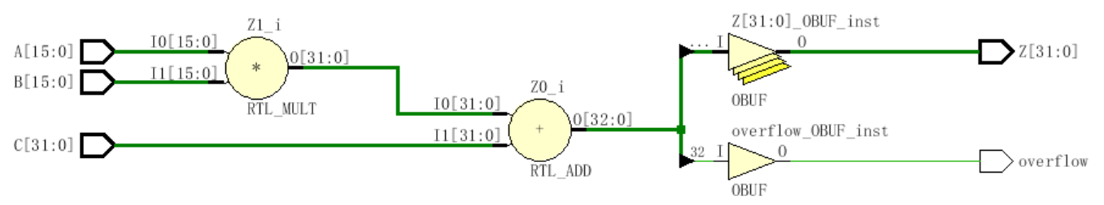
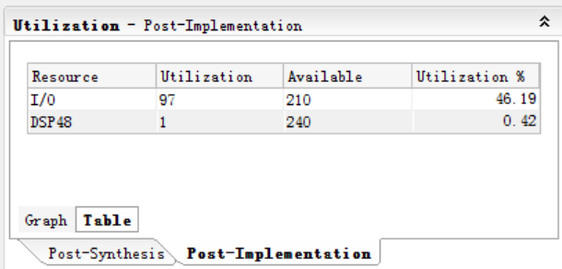
module mac(output [31:0] Z, output overflow,
input [15:0] A, B, input [31:0] C);
assign {overflow, Z} = A*B + C;
endmodule

Slide 43
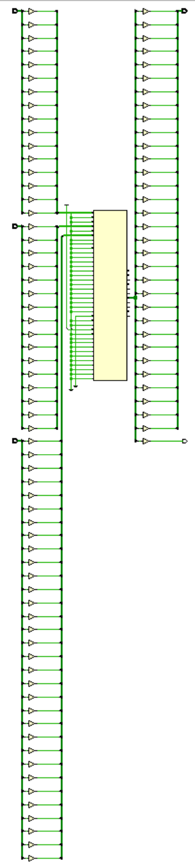
Notes:
Dsp模块很庞大，可以查表得到

Slide 44
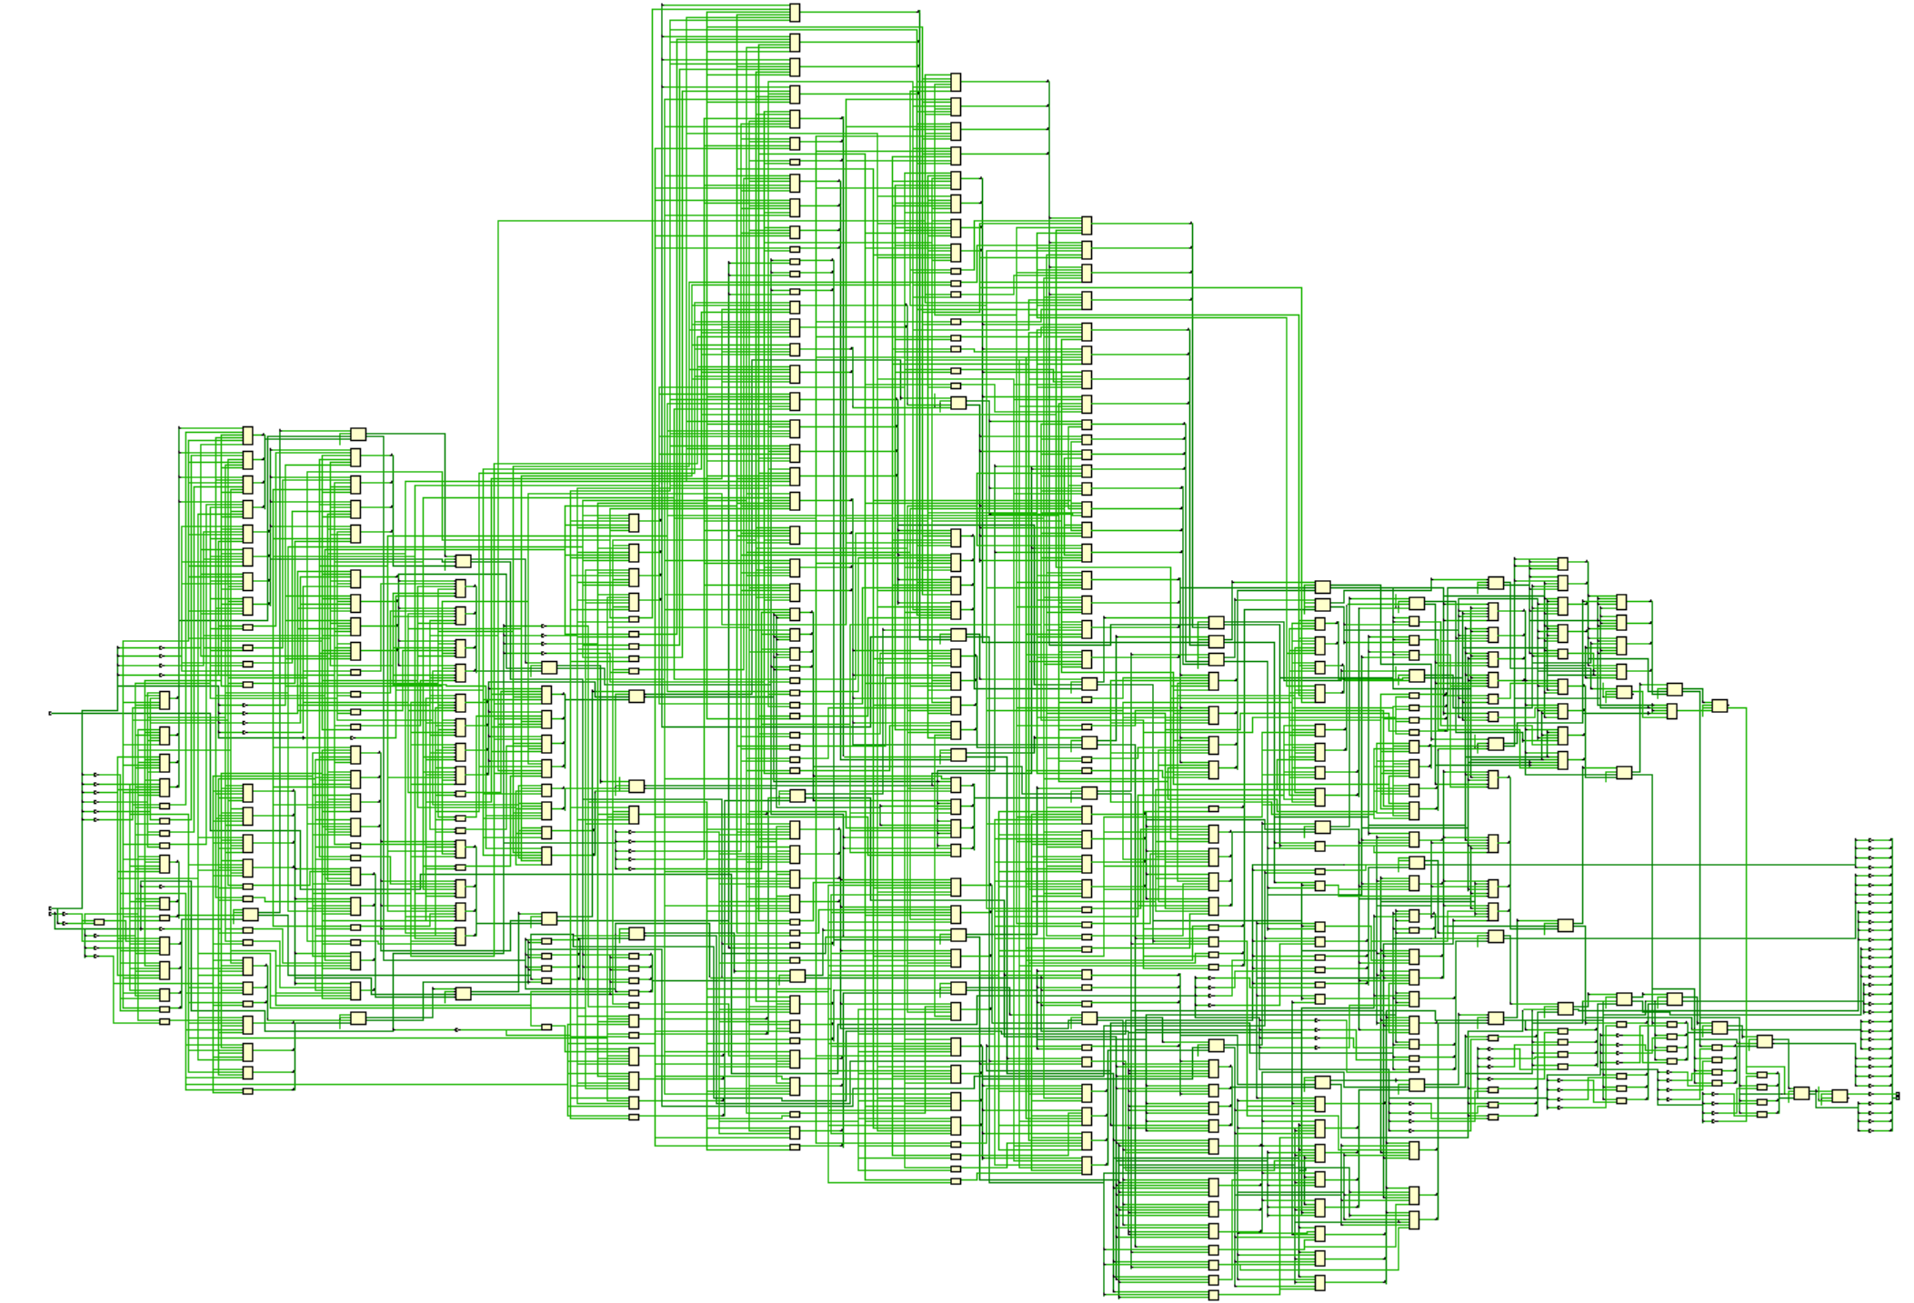

Slide 45
Outline
三种描述的举例说明
结构描述
数据描述
行为描述
  Initial

Slide 46
Behavioral Verilog
initial and always form basis of all behavioral Verilog
  All other behavioral statements occur within these
  initial and always blocks cannot be nested
  All <LHS> assignments must be to type reg
initial statements start at time 0 and execute once
  If there are multiple initial blocks they all start at time 0 and execute independently. They may finish independently.
If multiple behavioral statements are needed within the initial statement then the initial statement can be made compound with use of begin/end
Notes:
行为描述是用的最多的！！！
Initial 只会执行一次，用于初始化
Always 会反复执行，用于初始化后的执行
需要一个在两者之间的切换，需要驱动逻辑来选择，否则会冲突。
简单的方法是，一个电路只有一个驱动。
所以initial一般是不存在的，免得设置多个驱动。以后不要用initial来初始化。对于实验3的存储器，可以用initial来初始化。
Initial最好的地方是测试程序，因为测试程序用一次就完了。设计程序必须用always。
组合电路没有初始化，时序电路需要初始化，可以用置位和复位的方法来实现，而不用initial

Slide 47
More on initial statements
Initial statement very useful for testbenches
Initial statements don’t synthesize

Slide 48
initial Blocks
`timescale 1 ns / 100 fs
module full_adder_tb;
reg [3:0] stim;
wire s, c;
full_adder(sum, carry, stim[2], stim[1], stim[0]); // instantiate DUT
// monitor statement is special - only needs to be made once,
initial $monitor(“%t: s=%b c=%b stim=%b”, $time, s, c, stim[2:0]);
// tell our simulation when to stop
initial #50 $stop;
initial begin // stimulus generation
for (stim = 4’h0; stim < 4’h8; stim = stim + 1) begin
#5;
end
end
endmodule
all initial blocks start at time 0
multi-statement block enclosed by begin and end

Slide 49
Another initial Statement Example
module stim()
reg m,a,b,x,y;
initial
m = 1’b0;
initial begin
#5 a = 1’b1;
#25 b = 1’b1;//再过25个时间单位
end
initial begin
#10 x = 1’b1;
#25 y = 1’b1;
end
initial
#50 $finish;
endmodule
Time
Event
0
m = 1’b0
5
a = 1’b1
Modelsim
10
x = 1’b1
30
b = 1’b1
35
y = 1’b1
50
$finish
What events at what times will a verilog simulator produce?
Notes:
Initial默认从0时刻开始起作用
initial
#50 $finish;
Finish结束仿真
阻塞式赋值
#5 a = 1’b1;
#25 b = 1’b1;
a赋值完了以后，才会赋值给b

Slide 50
Outline
三种描述的举例说明
结构描述
数据描述
行为描述
  Initial
  always

Slide 51
always statements
Behavioral block operates CONTINUOUSLY
  Executes at time zero but loops continuously
  Can use a trigger list to control operation; @(a, b, c)
  In absense of a trigger list it will re-evaluate when the last <LHS> assignment completes.
module clock_gen (output reg clock);
initial
clock = 1’b0; // must initialize in initial block
always // no trigger list for this always
#10 clock = ~clock; // always will re-evaluate when
// last <LHS> assignment completes
endmodule
Notes:
Always有时候要在事件描述有效的时候，才能触发输入和输出。
always
#10 clock = ~clock;
这个是周期为20的时钟。这里没有条件触发。

Slide 52
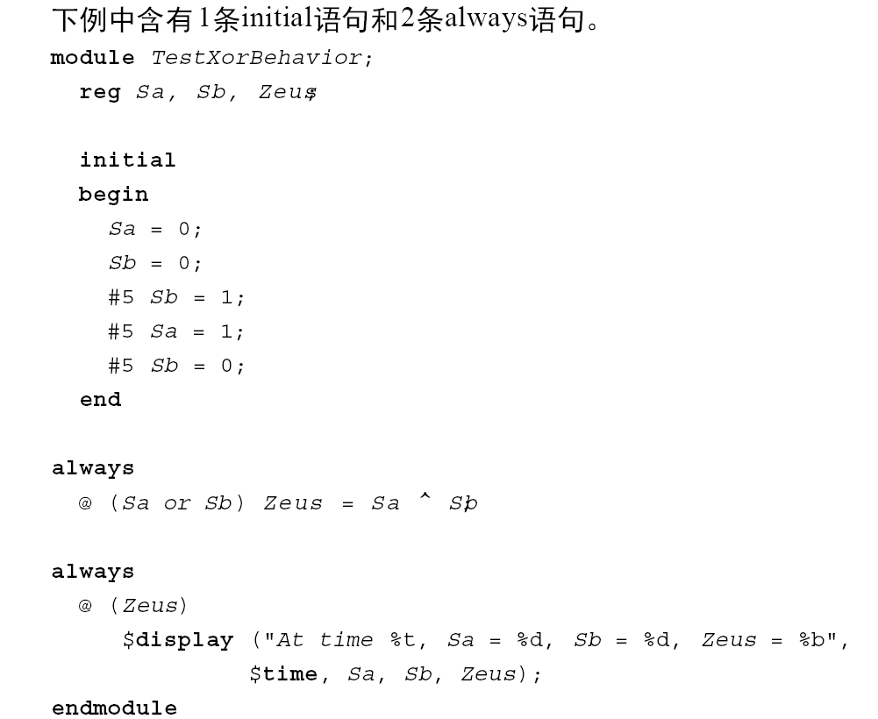
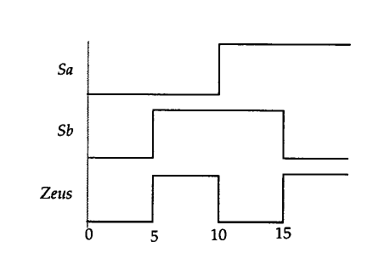
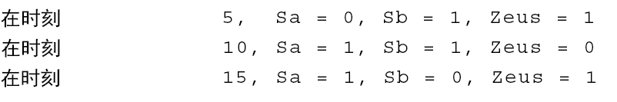
always vs initial
模块中的3条语句并行执行，其在模块中的书写次序并不重要。
Notes:
左边是一次波形；右边不断重复。

Slide 53
always vs initial
reg [7:0] v1, v2, v3, v4;
initial begin
v1 = 1;
#2 v2 = v1 + 1;
v3 = v2 + 1;
#2 v4 = v3 + 1;
v1 = v4 + 1;
#2 v2 = v1 + 1;
v3 = v2 + 1;
end
reg [7:0] v1, v2, v3, v4;
always begin
v1 = 1;
#2 v2 = v1 + 1;
v3 = v2 + 1;
#2 v4 = v3 + 1;
v1 = v4 + 1;
#2 v2 = v1 + 1;
v3 = v2 + 1;
end
What values does each block produce?
  Lets take our best guess
  You can try it youselves in a simulator
Notes:
左边是一次波形；右边不断重复。

Slide 54
Outline
三种描述的举例说明
结构描述
数据描述
行为描述
  Initial
  Always
  条件语句

Slide 55
Example: Comparator
module compare_4bit_behave(output reg A_lt_B, A_gt_B, A_eq_B,
input [3:0] A, B);
always@( ) begin
end
endmodule
Flush out this template with sensitivity list and implementation
Hint: a if…else if…else statement is best for implementation

Slide 56
if-else 条件语句
case 语句
for循环语句
if (条件表达式) 块语句1
else if (条件表达式2) 块语句2
……
else if (条件表达式n) 块语句n
else 块语句n+1
case (敏感表达式)
值1： 块语句1
值2： 块语句2
……
值n： 块语句n
default：块语句n+1
endcase
for (表达式1；表达式2；表达式3）块语句

Slide 57
if…else if…else statement
General forms…
If (condition)
begin
<statement1>;
<statement2>;
end
else
begin
<statement3>;
<statement4>;
end
If (condition)
begin
<statement1>;
<statement2>;
end
else if (condition2)
begin
<statement3>;
<statement4>;
end
else
begin
<statement5>;
<statement6>;
end
If (condition) begin
<statement1>;
<statement2>;
end
Of course the compound statements formed with begin/end are optional.
Multiple else if’s can be strung along indefinitely

Slide 58
How does and if…else if…else statement synthesize?
  Does not conditionally “execute” block of “code”
  Does not conditionally create hardware!
  It makes a multiplexer or selecting logic
  Generally:
    Hardware for both paths is created
    Both paths “compute” simultaneously
    The result is selected depending on the condition
if (func_add)
alu = a + b;
else if (func_and)
alu = a & b;
else
alu = 8’h00;
+
alu
a[7:0]
1
&
0
8
1
b[7:0]
8’h00
0
8
func_and
func_add
Notes:
是用多路选择器来实现if语句
就是用多路选择器来输出if需要输出的，if没有选中的，那么就不输出，但实际信号是有的。

Slide 59
if statement synthesis (continued)
if (a)
func = c & d;
else if (b)
func = c | d;
c
d
1
d
0
q
func
How does this
synthesize?
en
a
b
Latch??
What you ask for is what you get!
func is of type register. When neither a or b are asserted it didn’t not get a new value.
That means it must have remained the value it was before.
That implies memory…i.e. a latch!
Always have an
else to any if to avoid unintended
latches.

Slide 60
case Statements
Verilog has three types of case statements:
  case, casex, and casez
Performs bitwise match of expression and case item
  Both must have same bitwidth to match!
case
  Can detect x and z! (good for testbenches)
casez
  Uses z and ? as “don’t care” bits in case items and expression
casex
  Uses x, z, and ? as “don’t care” bits in case items and expression
Slide taken direct from Eric Hoffman

Slide 61
Case statement (general form)
case (expression)
alternative1 : statement1; // any of these statements could
alternative2 : statement2; // be a compound statement using
alternative3 : statement3; // begin/end
default : statement4 // always use default for synth stuff
endcase
parameter AND = 2’b00;
parameter OR = 2’b01;
parameter XOR = 2’b10;
case (alu_op)
AND : alu = src1 & src2;
OR : alu = src1 | src2;
XOR : alu = src1 ^ src2;
default : alu = src1 + src2;
endcase
Why always have a default?
Same reason as always having an else with an if statement.
All cases are specified, therefore no unintended latches.
Slide taken direct from Eric Hoffman

Slide 62
Using case To Detect x And z
Only use this functionality in a testbench!
Example taken from Verilog-2001 standard:
case (sig)
1’bz: $display(“Signal is floating.”);
1’bx: $display(“Signal is unknown.”);
default: $display(“Signal is %b.”, sig);
endcase
Slide taken direct from Eric Hoffman

Slide 63
casex Statement
Uses x, z, and ? as single-bit wildcards in case item and expression
Uses first match encountered
always @ (code) begin
casex (code) // case expression
2’b0?: control = 8’b00100110; // case item1
2’b10: control = 8’b11000010; // case item 2 2’b11: control = 8’b00111101; // case item 3
endcase
end
What is the output for code = 2’b01?
What is the output for code = 2’b1x?
Slide taken direct from Eric Hoffman

Slide 64
casez Statement
Uses z, and ? as single-bit wildcards in case item and expression
always @ (code) begin
casez (code)
2’b0?: control = 8’b00100110; // item 1
2’bz1: control = 8’b11000010; // item 2 default: control = 8b’xxxxxxxx; // item 3
endcase
end
What is the output for code = 2b’01?
What is the output for code = 2b’zz?
Slide taken direct from Eric Hoffman

Slide 65
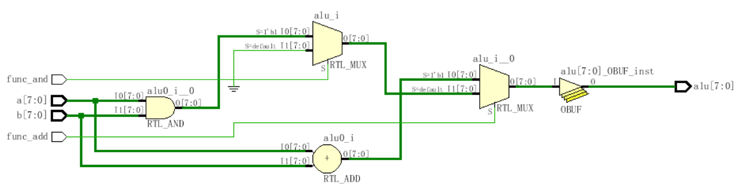
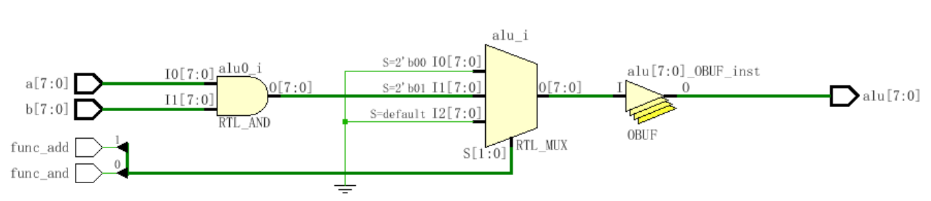
if (func_add)
alu = a + b;
else if (func_and)
alu = a & b;
else
alu = 8’h00;
case({func_add, func_and})
2'b00: alu = 8'h00;
2'b01: alu = a & b;
2'b1x: alu = func_add;
default: alu = 8'h00;
endcase
Notes:
Case和if的区别：
用if描述的语句的延迟输出不一样
用case描述的语句没有优先级，所以延迟输出是一样的
如果信号是一起的来，用case一起出比较好，是同步
如果信号不是一起的来，那么可以用if来让他们的一起出去，尽量实现同步

Slide 66
Outline
三种描述的举例说明
结构描述
数据描述
行为描述
  Initial
  Always
  条件语句
  循环语句

Slide 67
Loops in Verilog
We already saw the for loop:
reg [15:0] rf[0:15]; // memory structure for modeling register file
reg [5:0] w_addr; // address to write to
for (w_addr=0; w_addr<16; w_addr=w_addr+1)
rf[w_addr[3:0]] = 16’h0000; // initialize register file memory
There are 3 other loops available:
  While loops
  Repeat loop
  Forever loop

Slide 68
while loops
Executes until boolean condition is not true
  If boolean expression false from beginning it will never execute loop
reg [15:0] flag;
reg [4:0] index;
initial begin
index=0;
found=1’b0;
while ((index<16) && (!found)) begin
if (flag[index]) found = 1’b1;
else index = index + 1;
end
if (!found) $display(“non-zero flag bit not found!”);
else $display(“non-zero flag bit found in position %d”,index);
end
Handy for cases where loop termination is a more complex function.
Like a search

Slide 69
repeat Loop
Good for a fixed number of iterations
  Repeat count can be a variable but…
    It is only evaluated when the loops starts
    If it changes during loop execution it won’t change the number of iterations
Used in conjunction with @(posedge clk) it forms a handy & succinct way to wait in testbenches for a fixed number of clocks
initial begin
inc_DAC = 1’b1;
repeat(4095) @(posedge clk); // bring DAC right up to point of rollover
inc_DAC = 1’b0;
inc_smpl = 1’b1;
repeat(7)@(posedge clk); // bring sample count up to 7
inc_smpl = 1’b0;
end

Slide 70
forever loops
We got a glimpse of this already with clock generation in testbenches.
Only a $stop, $finish or a specific disable can end a forever loop.
initial begin
clk = 0;
forever #10 clk = ~ clk;
end
Clock generator is by far the most
common use of a forever loop
Notes:
这里是时钟的模拟代码的写法

Slide 71
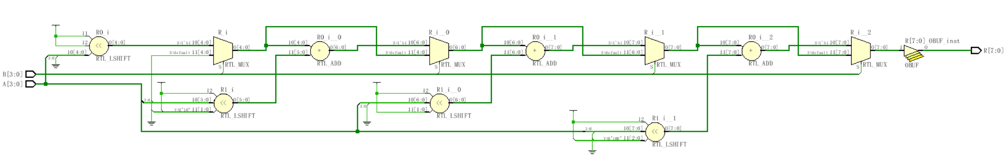
module mult4b(output reg [7:0] R, input [3:0] A, input [3:0] B);
integer i;
always @(A, B) begin
R = 0;
for(i=1; i<=4; i=i+1)
if(B[i-1]) R = R + (A<<i);
end
endmodule
Notes:
Verilog设计尽量不用循环语句，否则硬件成本太高，上图是四套电路的成本，最好做成流水

Slide 72
Outline
三种描述的举例说明
结构描述
数据描述
行为描述
  Initial
  Always
  条件语句
  循环语句
  赋值语句

Slide 73
基本形式：<寄存器变量>＝<表达式>；
外部模式：<定时控制> <寄存器变量>＝<表达式>；
内部模式：<寄存器变量>＝ <定时控制> <表达式>；
定时控制分为两类：延时控制
事件控制 @(事件控制敏感表）
赋值语句
阻塞型过程赋值
  赋值算符“＝” ：前一条语句没有完成赋值过程之前，后面的语句不可能被执行。
非阻塞型过程赋值
  赋值算符“<＝” ：一条非阻塞型赋值语句的执行，并不会影响块中其它语句的执行。
连续赋值语句
  只要输入端操作数的值发生变化，该语句就重新计算并刷新赋值结果。用关键词assign来区分。
Notes:
数据流里用的赋值语句是连续赋值语句。因为只要右边改变，左边就会改变，所以是连续赋值语句。
<=和=只能在always块里面用
在Verilog中有两种类型的赋值语句：阻塞赋值语句（“=”）和非阻塞赋值语句（“<=”）。正确地使用这两种赋值语句对于Verilog的设计和仿真非常重要。
Verilog语言中讲的阻塞赋值与非阻塞赋值，但从字面意思来看，阻塞就是执行的时候在某个地方卡住了，等这个操作执行完在继续执行下面的语句，而非阻塞就是不管执行完没有，我不管执行的结果是什么，反正我继续下面的事情。而Verilog中的阻塞赋值与非阻塞赋值正好也是这个意思，通过执行一个例子，就可以简单地明白了：
1、阻塞赋值可以理解为语句的顺序执行，因此语句的执行顺序很重要
2、非阻塞赋值可以理解为语句的并行执行，所以语句的执行不考虑顺序
3、在assign的结构中，必须使用的是阻塞赋值

Slide 74
Blocking vs non-Blocking
Blocking “Evaluated” sequentially
Works a lot like software (danger!)
Used for combinational logic
module addtree(output reg [9:0] out,
input [7:0] in1, in2, in3, in4);
reg [8:0] part1, part2;
always @(in1, in2, in3, in4) begin
part1 = in1 + in2;
part2 = in3 + in4;
out = part1 + part2;
end
endmodule
in1
in2
in3
in4
+
+
part1
part2
+
out
Slide taken direct from Eric Hoffman
Notes:
对于组合电路，只用阻塞式赋值，一般不用非阻塞式。

Slide 75
Non-Blocking Assignments
“Updated” simultaneously if no delays given
Used for sequential logic
module swap(output reg out0, out1, input rst, clk);
always @(posedge clk) begin
if (rst) begin
out0 <= 1’b0;
out1 <= 1’b1;
end
else begin
out0 <= out1;
out1 <= out0;
end
end
endmodule
D Q
rst to 0
out0
rst
clk
D Q
rst to 1
out1
Slide taken direct from Eric Hoffman

Slide 76
Swapping if done in Blocking
In blocking, need a “temp” variable
module swap(output reg out0, out1, input in0, in1, swap);
reg temp;
always @(*) begin
out0 = in0;
out1 = in1;
if (swap) begin
temp = out0;
out0 = out1;
out1 = temp;
end
end
endmodule
Which values get included on the sensitivity list from *?
in0
in1
out0
swap
out1
Slide taken direct from Eric Hoffman

Slide 77
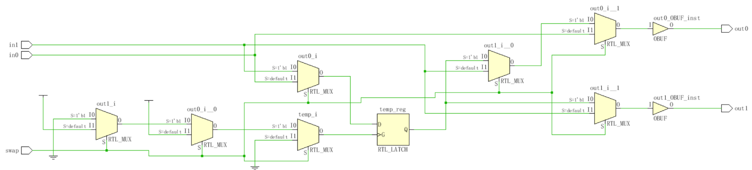
Swapping if done in Non-Blocking
module swap(output reg out0, out1, input in0, in1, swap);
reg temp;
always @(*) begin
out0 <= in0;
out1 <= in1;
if (swap) begin
temp <= out0;
out0 <= out1;
out1 <= temp;
end
end
endmodule

Slide 78
More on Blocking
Called blocking because….
  The evaluation of subsequent statements <RHS> are blocked, until the <LHS> assignment of the current statement is completed.
q1
q2
q3
module pipe(clk, d, q);
input clk,d;
output q;
reg q;
always @(posedge clk) begin
q1 = d;
q2 = q1;
q3 = q2;
end
endmodule
d
clk
Lets code this
Simulate this in your head…
Remember blocking behavior of: <LHS> assigned before
<RHS> of next evaluated.
Does this work as intended?
Slide taken direct from Eric Hoffman
Notes:
always @(posedge clk) begin
q1 = d;
q2 = q1;
q3 = q2;
End
q1,q2,q3均是d，不是移位逻辑

Slide 79
More on Non-Blocking
Lets try that again
q1
q2
q3
d
module pipe(clk, d, q);
input clk,d;
output q;
reg q;
always @(posedge clk) begin
q1 <= d;
q2 <= q1;
q3 <= q2;
End
endmodule;
clk
Lets code this
With non-blocking statements the <RHS> of subsequent statements are not blocked. They are all evaluated simultaneously.
The assignment to the <LHS> is then scheduled to occur.
This will work as intended.
Slide taken direct from Eric Hoffman
Notes:
always @(posedge clk) begin
q1 <= d;
q2 <= q1;
q3 <= q2;
End
这个电路就能实现如图的移位器。
所以纯时序电路，用非阻塞式赋值。
建议：不要阻塞式和非阻塞式赋值在一起赋值，否则电路会很怪。
所以有问题的时候，很可能是阻塞式赋值和非阻塞赋值搞混了。

Slide 80
So Blocking is no good and we should always use Non-Blocking??
Consider combinational logic
module ao4(z,a,b,c,d);
input a,b,c,d;
output z;
reg z,tmp1,tmp2;
always @(a,b,c,d) begin
tmp1 <= a & b;
tmp2 <= c & d;
z <= tmp1 | tmp2;
end
endmodule
The inputs (a,b,c,d) in the sensitivity list change, and the always block is evaluated.
New assignments are scheduled for tmp1 & tmp2 variables.
A new assignment is scheduled for z using the previous tmp1 & tmp2 values.
Does this work?
Slide taken direct from Eric Hoffman

Slide 81
Why not non-Blocking for Combinational
Can we make this example work?
module ao4(z,a,b,c,d);
input a,b,c,d;
output z;
reg z,tmp1,tmp2;
always @(a,b,c,d) begin
tmp1 <= a & b;
tmp2 <= c & d;
z <= tmp1 | tmp2;
end
endmodule
module ao4(z,a,b,c,d);
input a,b,c,d;
output z;
reg z,tmp1,tmp2;
always @(a,b,c,d,tmp1,tmp2) begin
tmp1 <= a & b;
tmp2 <= c & d;
z <= tmp1 | tmp2;
end
endmodule
Yes
Put tmp1 & tmp2 in the trigger list
What is the downside of this?
Slide taken direct from Eric Hoffman

Slide 82
结论
1、时序逻辑，使用“非阻塞赋值”。
2、组合逻辑，使用“阻塞赋值”
3、 当在同一个always块里面既为组合逻辑又为时序逻辑时，使用“非阻塞赋值”。

Slide 83
Outline
三种描述的举例说明
结构描述
数据描述
行为描述
  Initial
  Always
  条件语句
  循环语句
  赋值语句
  时序控制语句

Slide 84
时序控制
  由“#”符号引入的延迟控制。它将程序的执行过程中断一定的时间，时间的长度由<time>的值来确定。
  由“@”符号引入的事件控制。一个事件可以通过运行表达式“-> event”变量被激发。
  等待语句。直到表达式计算为真之前，都延时下一个语句的执行。
  延迟定义块。对模块中某一指定
  的路径进行延迟定义，这一路径
  连接模块的输入端口与输出端口
  （或双向端口）。
＃ <time> <statement> ；
@ (<posedge>|<negedge>|<signals> ) <statement>；
wait (<expression>) <statement> ；
specify
(<expression>) = <time>
……
endspecify

Slide 85
disable Statement
Similar to the “break” statement in C
  Disables execution of the current block (not permanently)
begin : break
for (i = 0; i < n; i = i+1) begin : continue
@(posedge clk)
if (a == 0) // "continue" loop
disable continue;
if (a == b) // "break" from loop
disable break;
statement1
statement2
end
end
What occurs if (a==0)?
What occurs if (a==b)?
How do they differ?

Slide 86
Outline
三种描述的举例说明
结构描述
数据描述
行为描述
其他论题
  函数和任务

Slide 87
函数（function）
任务（task）
函数和任务结构之间的差异：
  一个任务块可以含有时间控制结构，而函数块则没有；
  一个任务块可以有输入和输出，而函数块必须有至少一个输入，没有任何输出；
  任务块的引发是通过一条语句，而函数块只有当它被引用在一个表达式中时才会生效。
function <位宽说明> 函数名；
输入端口与类型说明；
局部变量说明；
块语句
endfunction
task 任务名；
端口与类型说明；
局部变量说明；
块语句
endtask
Notes:
规则：
Always里面不能嵌套数据流和结构流的描述（比如，assign或是AND）
行为描述的语句（比如if）不能放在always外面，否则认为是
但有可能我们需要复杂的功能，这时可以用任务和函数来接解决。

Slide 88
functions
Declared and referenced within a module
Used to implement combinational behavior
  Contain no timing controls or tasks
Inputs/outputs
  Must have at least one input argument
  Has only one output (no inouts)
  Function name is implicitly declared return variable
  Type and range of return value can be specified (1-bit wire is default)
Slide taken direct from Eric Hoffman

Slide 89
When to use functions?
Usage rules:
  May be referenced in any expression (RHS)
  May call other functions
Requirements of procedure (implemented as function)
  No timing or event control
  Returns a single value
  Has at least 1 input
  Uses only behavioral statements
  Only uses blocking assignments (combinational)
Mainly useful for conversions, calculations, and selfchecking routines that return boolean. (testbenches)
Slide taken direct from Eric Hoffman

Slide 90
Function Example
module word_aligner (word_out, word_in);
output [7: 0] word_out;
input [7: 0] word_in;
assign word_out = aligned_word(word_in); // invoke function
function [7: 0] aligned_word; // function declaration
input [7: 0] word;
begin
aligned_word = word;
if (aligned_word != 0)
while (aligned_word[7] == 0) aligned_word = aligned_word << 1;
end
endfunction
endmodule
size of return value
input to function
Does this synthsize?
Slide taken direct from Eric Hoffman
Notes:
函数里面不能有时序
这个不能综合，因为function里面有while循环，所以综合无法得知需要几套电路。

Slide 91
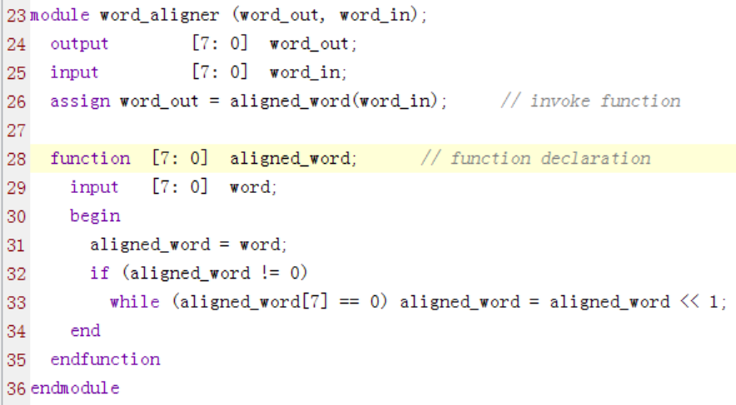
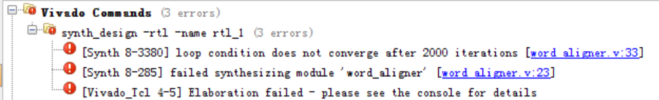
Function Example

Slide 92
Function Example [2]
module arithmetic_unit (result_1, result_2, operand_1, operand_2,);
output [4: 0] result_1;
output [3: 0] result_2;
input [3: 0] operand_1, operand_2;
assign result_1 = sum_of_operands (operand_1, operand_2);
assign result_2 = larger_operand (operand_1, operand_2);
function [4: 0] sum_of_operands(input [3:0] operand_1, operand_2);
sum_of_operands = operand_1 + operand_2;
endfunction
function [3: 0] larger_operand(input [3:0] operand_1, operand_2);
larger_operand = (operand_1 >= operand_2) ? operand_1 : operand_2;
endfunction
endmodule
function call
function inputs
function output
Slide taken direct from Eric Hoffman

Slide 93
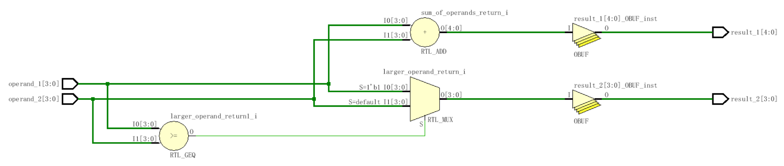
Function Example [2]

Slide 94
tasks (much more useful than functions)
Functions: | Tasks:
A function can enable another function, but not another task | A task can enable other tasks and functions
Functions must execute in zero delay | Tasks may execute in non-zero simulation time
Functions can have no timing or even control statements | Tasks may contain delay, event or timing control. (i.e. ➔ @, #)
Function must have at least one input argument. | Task may have zero or more arguments of type input, output, or inout
Fucntions always return a single value. The cannot have output or inout arguments | Task do not return a value, but rather pass multiple values through output and input arguments
Tasks can modify global signals too, perhaps naughty, but I do it all the time.
Slide taken direct from Eric Hoffman
Notes:
函数不能调用任务
任务可以什么都调用
函数是0延迟
任务可以有时序，可以有事件，有延迟
函数必须有一个输入，只返回单个值
任务可以没有输入，任务可以返回多个值或没有值，任务其实很像模块，可以在行为描述里面使用。

Slide 95
Why use Tasks?
Tasks provide the ability to
  Execute common procedures from multiple places
  Divide large procedures into smaller ones
Local variables can be declared & used
Personally, I only use tasks in testbenches, but they are very handy there.
  Break common testing routines into tasks
    Initialization tasks
    Stimulus generation tasks
    Self Checking tasks
  Top level test then becomes mainly calls to tasks.
Slide taken direct from Eric Hoffman

Slide 96
Task Example [Part 1]
module adder_task (c_out, sum, clk, reset, c_in, data_a, data_b);
output reg [3: 0] sum;
output reg c_out;
input [3: 0] data_a, data_b;
input clk, reset, c_in;
always @(posedge clk or posedge reset) begin
if (reset) {c_out, sum} <= 0;
else add_values (sum, c_out, data_a, data_b, c_in); // invoke task
end
// Continued on next slide
Calling of task
Slide taken direct from Eric Hoffman
Notes:
Add_values是任务，可以在行为描述里面调用，而这里的add_value像一个结构描述
所以用任务可以类实现：行为和结构描述的结合

Slide 97
Task Example [Part 2]
// Continued from previous slide
task add_values; // task declaration
output reg [3: 0] SUM;
output reg C_OUT;
input [3: 0] DATA_A, DATA_B;
input C_IN;
{C_OUT, SUM} = DATA_A + (DATA_B + C_IN);
endtask
endmodule
Could have instead specified inputs/outputs using a port list.
task add_values (output reg [3: 0] SUM, output reg C_OUT,
input [3:0] DATA_A, DATA_B, input C_IN);
task outputs
task inputs
Slide taken direct from Eric Hoffman

Slide 98
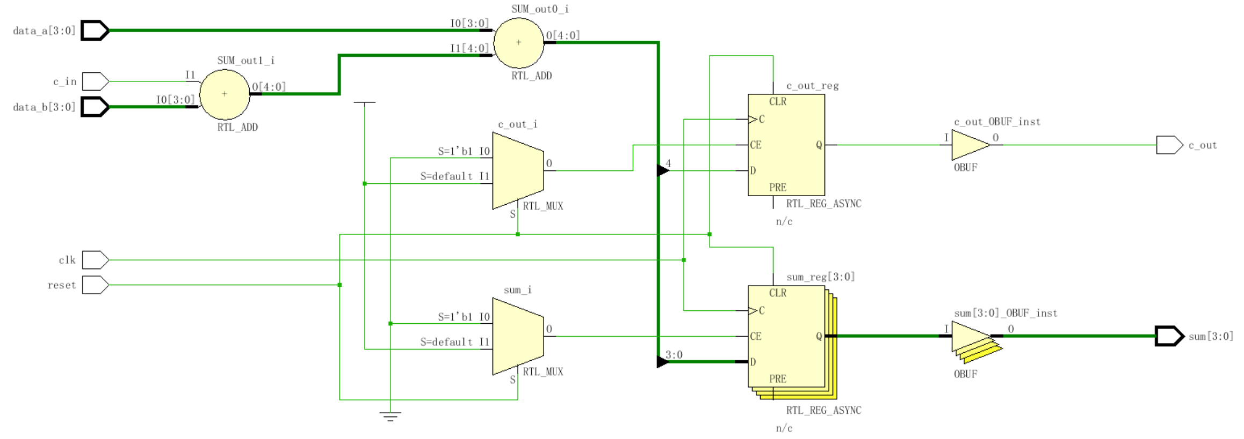
Task Example [Part 3]

Slide 99
task 和 function 的不同：
1）函数只能与主模块共用同一个仿真的时间单位，而任务可以自己定义自己的仿真时间单位。
2）函数不能启动任务，但是可以调用其它函数，但是任务可以调用其他函数和任务；
3）函数至少要有一个输入变量，而任务可以没有或者有多个任何类型的变量。
4）函数返回一个值，而任务不返回任何值。

Slide 100
Outline
三种描述的举例说明
结构描述
数据描述
行为描述
其他论题
  任务和函数
  文件输入和输出

Slide 101
File I/O – Why?
If we don’t want to hard-code all information in the testbench, we can use input files
Help automate testing
  One file with inputs
  One file with expected outputs
Can have a software program generate data
  Create the inputs for testing
  Create “correct” output values for testing
  Can use files to “connect” hardware/software system

Slide 102
Opening/Closing Files
$fopen opens a file and returns an integer descriptor
  integer fd = $fopen(“filename”);
  integer fd = $fopen(“filename”, r);
  If file cannot be open, returns a 0
  Can output to more than one file simultaneously by writing to the OR ( | ) of the relevant file descriptors
    Easier to have “summary” and “detailed” results
$fclose closes the file
$fclose(fd);

Slide 103
Writing To Files
Output statements have file equivalents
  $fmonitor()
  $fdisplay()
  $fstrobe()
  $fwrite() // write is like a display without the \n
These system calls take the file descriptor as the first argument
  $fdisplay(fd, “out=%b in=%b”, out, in);

Slide 104
Reading From Files
Read a binary file: $fread(destination, fd);
  Can specify start address & number of locations too
  Good luck! I have never used this.
Very rich file manipulation (see IEEE Standard)
  $fseek(), $fflush(), $ftell(), $rewind(), …
Will cover a few of the more common read commands next

Slide 105
Using $fgetc to read characters
module file_read()
parameter EOF = -1;
integer file_handle,error,indx;
reg signed [15:0] wide_char;
reg [7:0] mem[0:255];
reg [639:0] err_str;
initial begin
indx=0;
file_handle = $fopen(“text.txt”,”r”);
error = $ferror(file_handle,err_str);
if (error==0) begin
wide_char = 16’h0000;
while (wide_char!=EOF) begin
wide_char = $fgetc(file_handle);
mem[indx] = wide_char[7:0];
$write(“%c”,mem[indx]);
indx = indx + 1;
end
end
else $display(“Can’t open file…”);
$fclose(file_handle);
end
endmodule
The quick brown fox jumped over the lazy dogs
text.txt
When finished the array mem will contain the characters of this file one by one, and the file will have been echoed to the screen.
Why wide_char[15:0] and why signed?

Slide 106
Using $fgets to read lines
module file_read2()
integer file_handle,error,indx,num_bytes_in_line;
reg [256*8:1] mem[0:255],line_buffer;
reg [639:0] err_str;
initial begin
indx=0;
file_handle = $fopen(“text2.txt”,”r”);
error = $ferror(file_handle,err_str);
if (error==0) begin
num_bytes_in_line = $fgets(line_buffer,file_handle);
while (num_bytes_in_line>0) begin
mem[indx] = line_buffer;
$write(“%s”,mem[indx]);
indx = indx + 1;
num_bytes_in_line = $fgets(line_buffer,file_handle);
end
end
else $display(“Could not open file text2.txt”);
$fgets() returns the number of bytes in the line. When this is a
zero you know you hit EOF.

Slide 107
Using $fscanf to read files
module file_read3()
integer file_handle,error,indx,num_matches;
reg [15:0] mem[0:255][1:0];
reg [639:0] err_str;
initial begin
indx=0;
file_handle = $fopen(“text3.txt”,”r”);
error = $ferror(file_handle,err_str);
if (error==0) begin
num_matches = $fscanf(file_handle,”%h %h”,mem[indx][0],mem[indx][1]);
while (num_matches>0) begin
$display(“data is: %h %h”,mem[indx][0],mem[indx[1]);
indx = indx + 1;
num_matches = $fscanf(file_handle,”%h %h”,mem[indx][0],mem[indx][1]);
end
end
else $display(“Could not open file text3.txt”);
12f3 13f3
abcd 1234
3214 21ab
text3.txt

Slide 108
Loading Memory Data From Files
This is very useful (memory modeling & testbenches)
  $readmemb(“<file_name>”,<memory>);
  $readmemb(“<file_name>”,<memory>,<start_addr>,<finish_addr>);
  $readmemh(“<file_name>”,<memory>);
  $readmemh(“<file_name>”,<memory>,<start_addr>,<finish_addr>);
$readmemh ➔ Hex data…$readmemb ➔ binary data
  But they are reading ASCII files either way (just how numbers are represented)
// addr data
@0000 10100010
@0001 10111001
@0002 00100011
// addr data
@0000 A2
@0001 B9
@0002 23
//data
A2
B9
23
example “binary”
file
example “hex”
file
address is optional for the lazy

Slide 109
Example of $readmemh
module rom(input clk; input [7:0] addr; output [15:0] dout);
reg [15:0] mem[0:255]; // 16-bit wide 256 entry ROM
reg [15:0] dout;
initial
$readmemh(“constants”,mem);
always @(negedge clk) begin
///////////////////////////////////////////////////////////
// ROM presents data on clock low //
/////////////////////////////////////////////////////////
dout <= mem[addr];
end
endmodule
Notes:
存储器初始化的例子！！
用了initial

Slide 110
‘Include Compiler Directives
`include filename
  Inserts entire contents of another file at compilation
  Can be placed anywhere in Verilog source
  Can provide either relative or absolute path names
Example 1:
    module use_adder8(…);
    `include “adder8.v” // include the task for adder8
Example 2:
    module cppc_dig_tb();
    `include “/home/ehoffman/ece551/project/tb_tasks.v”
Useful for including tasks and functions in multiple modules

